Slide 1
What Makes a Good Teacher Great?
Ling Tong
Notes:
A great teacher will be remembered by students throughout their lifetime. Since 2020, Many instructors have been facing a challenge of how to deliver effective courses to future health care professionals during the pandemic. In this 20-minutes talk, Ling Tong will summarize his experience in teaching. This talk includes three points: (1) How to effectively support students during pandemic in an online class; (2) How to have students engaged to the course materials, and (3) How to integrate love and humanity to students in a class. Ling will provide his answer to the ever-existing question for teaching: “What makes a good teacher great”, and use his teaching philosophy to answer this question.

Slide 2
1. Teaching Philosophy
Notes:
A great teacher will be remembered by students throughout their lifetime. Since 2020, Many instructors have been facing a challenge of how to deliver effective courses to future health care professionals during the pandemic. In this 20-minutes talk, Ling Tong will summarize his experience in teaching. This talk includes three points: (1) How to effectively support students during pandemic in an online class; (2) How to have students engaged to the course materials, and (3) How to integrate love and humanity to students in a class. Ling will provide his answer to the ever-existing question for teaching: “What makes a good teacher great”, and use his teaching philosophy to answer this question.

Slide 3
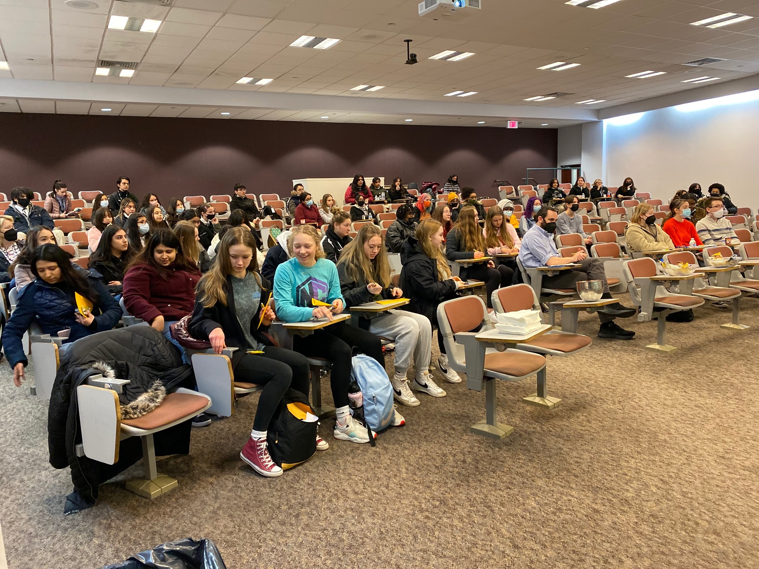
Notes:
In my school, I feel fortunate to have a group of students in my class.
Because I can work with people who are active, energetic, creative, and insightful.
That’s why I want to be a good teacher.
So, I will always ask them this question.
what makes a good teacher great?
When I throw out this this question in the first class, I can read something from their face.
They feel uncertain. The schools are afraid.
If you think yourself as a first-year college students.
Their feelings becomes so reasonable.
Some of them are first-generation college students,
Some are just come from your local grocery store, but they have a very big dream of becoming a medical professionals.
They want us to navigate what’s the world look like.
They want us to see the world inside of them.
That’s why they come to a college, because a college promise to them: you can see a bigger world.
That’s why they need a navigator, to help them find something they really love.

Slide 4
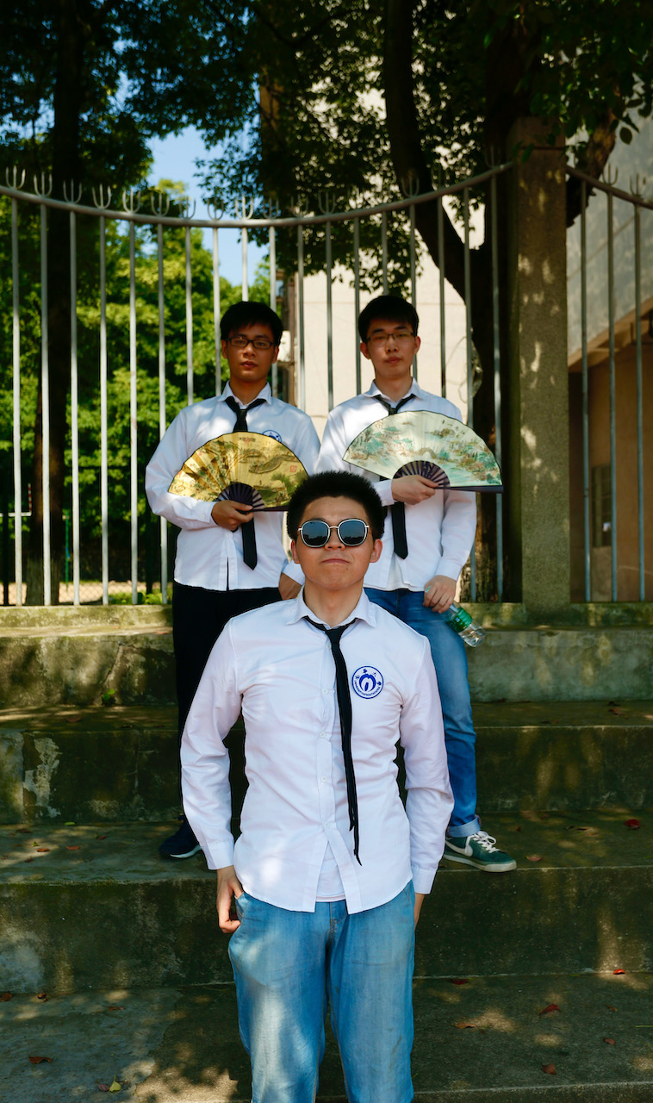
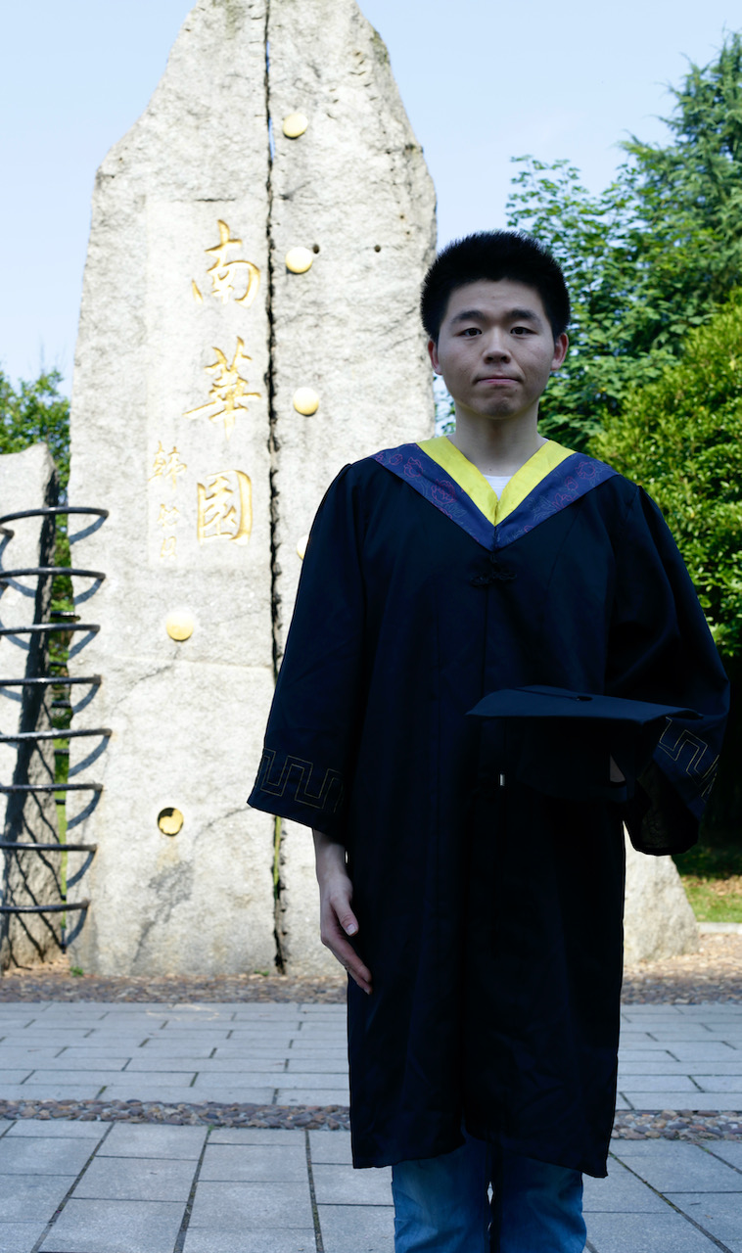
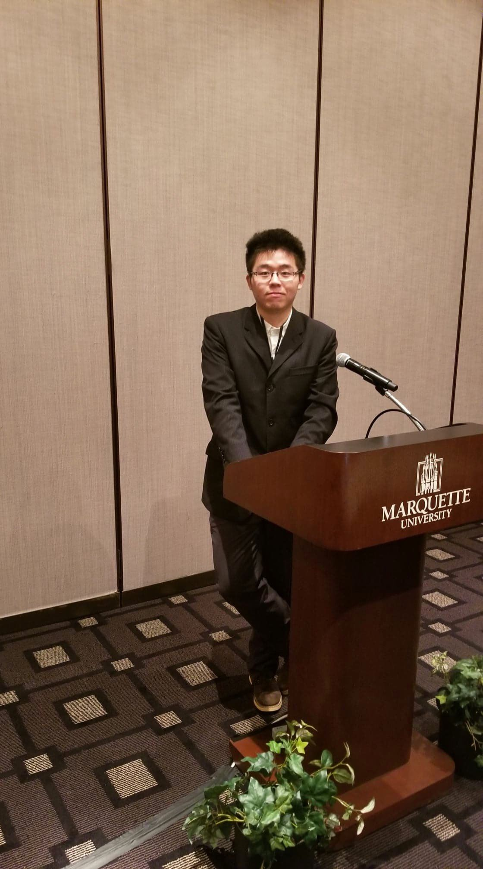
Notes:
So I decided to have a recap, what I was thinking in my life as a younger me.
So here is a couple of flashbacks In my mind:
What times I will say a teacher is great?
Does a good teacher mean they know everything?
No, probably not, because no one compares to Google. Google can teach me anything in the world.
Learning through google is faster than any teachers.
But why I feel I still need a professor in my life?

Slide 5
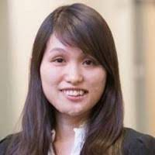
Lingyun Luo, Associate Professor
University of South China
Expertise: Medical Informatics
Notes:
Until I meet my advisor in my fourth year,
I finally realized why I took so long to find what makes a good teacher.
By the way, she is Lingyun Luo, a professor in University of South China.
She told me everything about what makes a good teacher.

Slide 6
A great teacher thinks like a kid,
But acts like an adult.
Notes:
And her answer to my question is this sentence.
A great teacher thinks like a kid, but a acts like an adult.
Kids have their own languages: If you happened to be a teenager’s parents, you know what do I mean.
They will speak something only to their friend, not to you.
I realized it was very true. Because just a few years ago, I was exact one of them.

Slide 7
1 The Love of Supporting
Notes:
When this came to my mind, what do I want to learn from my teachers?
I don’t expect to learn anything from my teachers,
I don’t want my teachers to act like me,
But I want a teacher to support me and keep me safe.
So, I can safely explore the topic and find a bigger world of myself.
With that in mind, a good teacher is like a parent to kids,
But in our own field of knowledge.
What’s more important than the knowledge, is the emotional support.
That becomes my first point of being a good teacher.
teachers need to have the love to support their journey in a college.

Slide 8
Notes:
When the covid-19 lockdown happens, everything is in a massive change
We have to go from this situation -

Slide 9
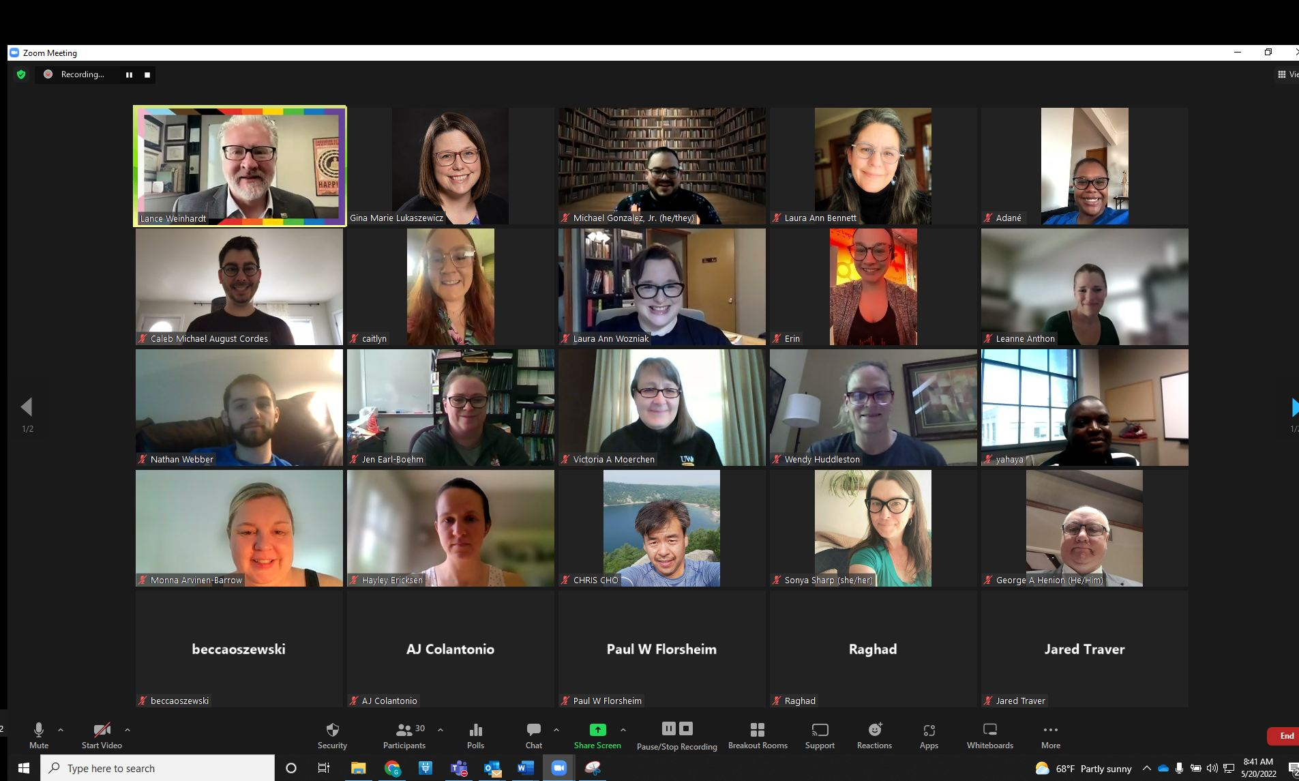
Notes:
To thi situation
To virtual environment:
It was a big struggle, just like everyone else.
We have to change everything.
For the class, I tried online meeting, I used a new online class material, and I designed new online assignments.
Everything was now online, so students don’t have to learn the same thing in my physical lecture.
After I set up everything, a student talks to me.
Professor, I actually like the online video much more than your talk….
I’m a bit upset, but that’s actually a great feedback
During this change, one student has written an evaluation to me:

Slide 10
I really appreciate the lecture is getting online during the pandemic.
Notes:
I really appreciate the lecture is getting online during the pandemic.
One student said,
Actually, I love the online videos much more than your lectures.
That’s fine, I was not offended at all.
As long as I learned something is good to them as a teacher, I should keep up the work.

Slide 11
My attendance would have been impossible, if he did not provide online course.

Slide 12
This professor is formatting our classes for what matters to our future jobs.

Slide 13
2 The Love of Learning to Change
Notes:
During That change, I realized what the students really mean:
a great teachers not only love to teach.
But a great teacher should love to learn.
the reason this is significant is, they don’t see this happening.
They don’t see many teachers are learning in front of them.
They see them just teaching.
But they wish they would learn along with them, just like what I did during that shift.
Think about it, a college hire teachers to be content experts,
To have all of the knowledge, not to be learners.
But what if you did?
What if you showed up in the classroom, and have something prepared, and said:
I don’t know exactly what we’re going to do, But I can’t wait to learn something new with you.
did you see if you struggle on something in front of them,
And finally discover the answer.
That is the moment every student will see how you’re going to solve that problem.
They want to be inspired by this idea that learning is important.
But they don’t see it very often in schools.

Slide 14
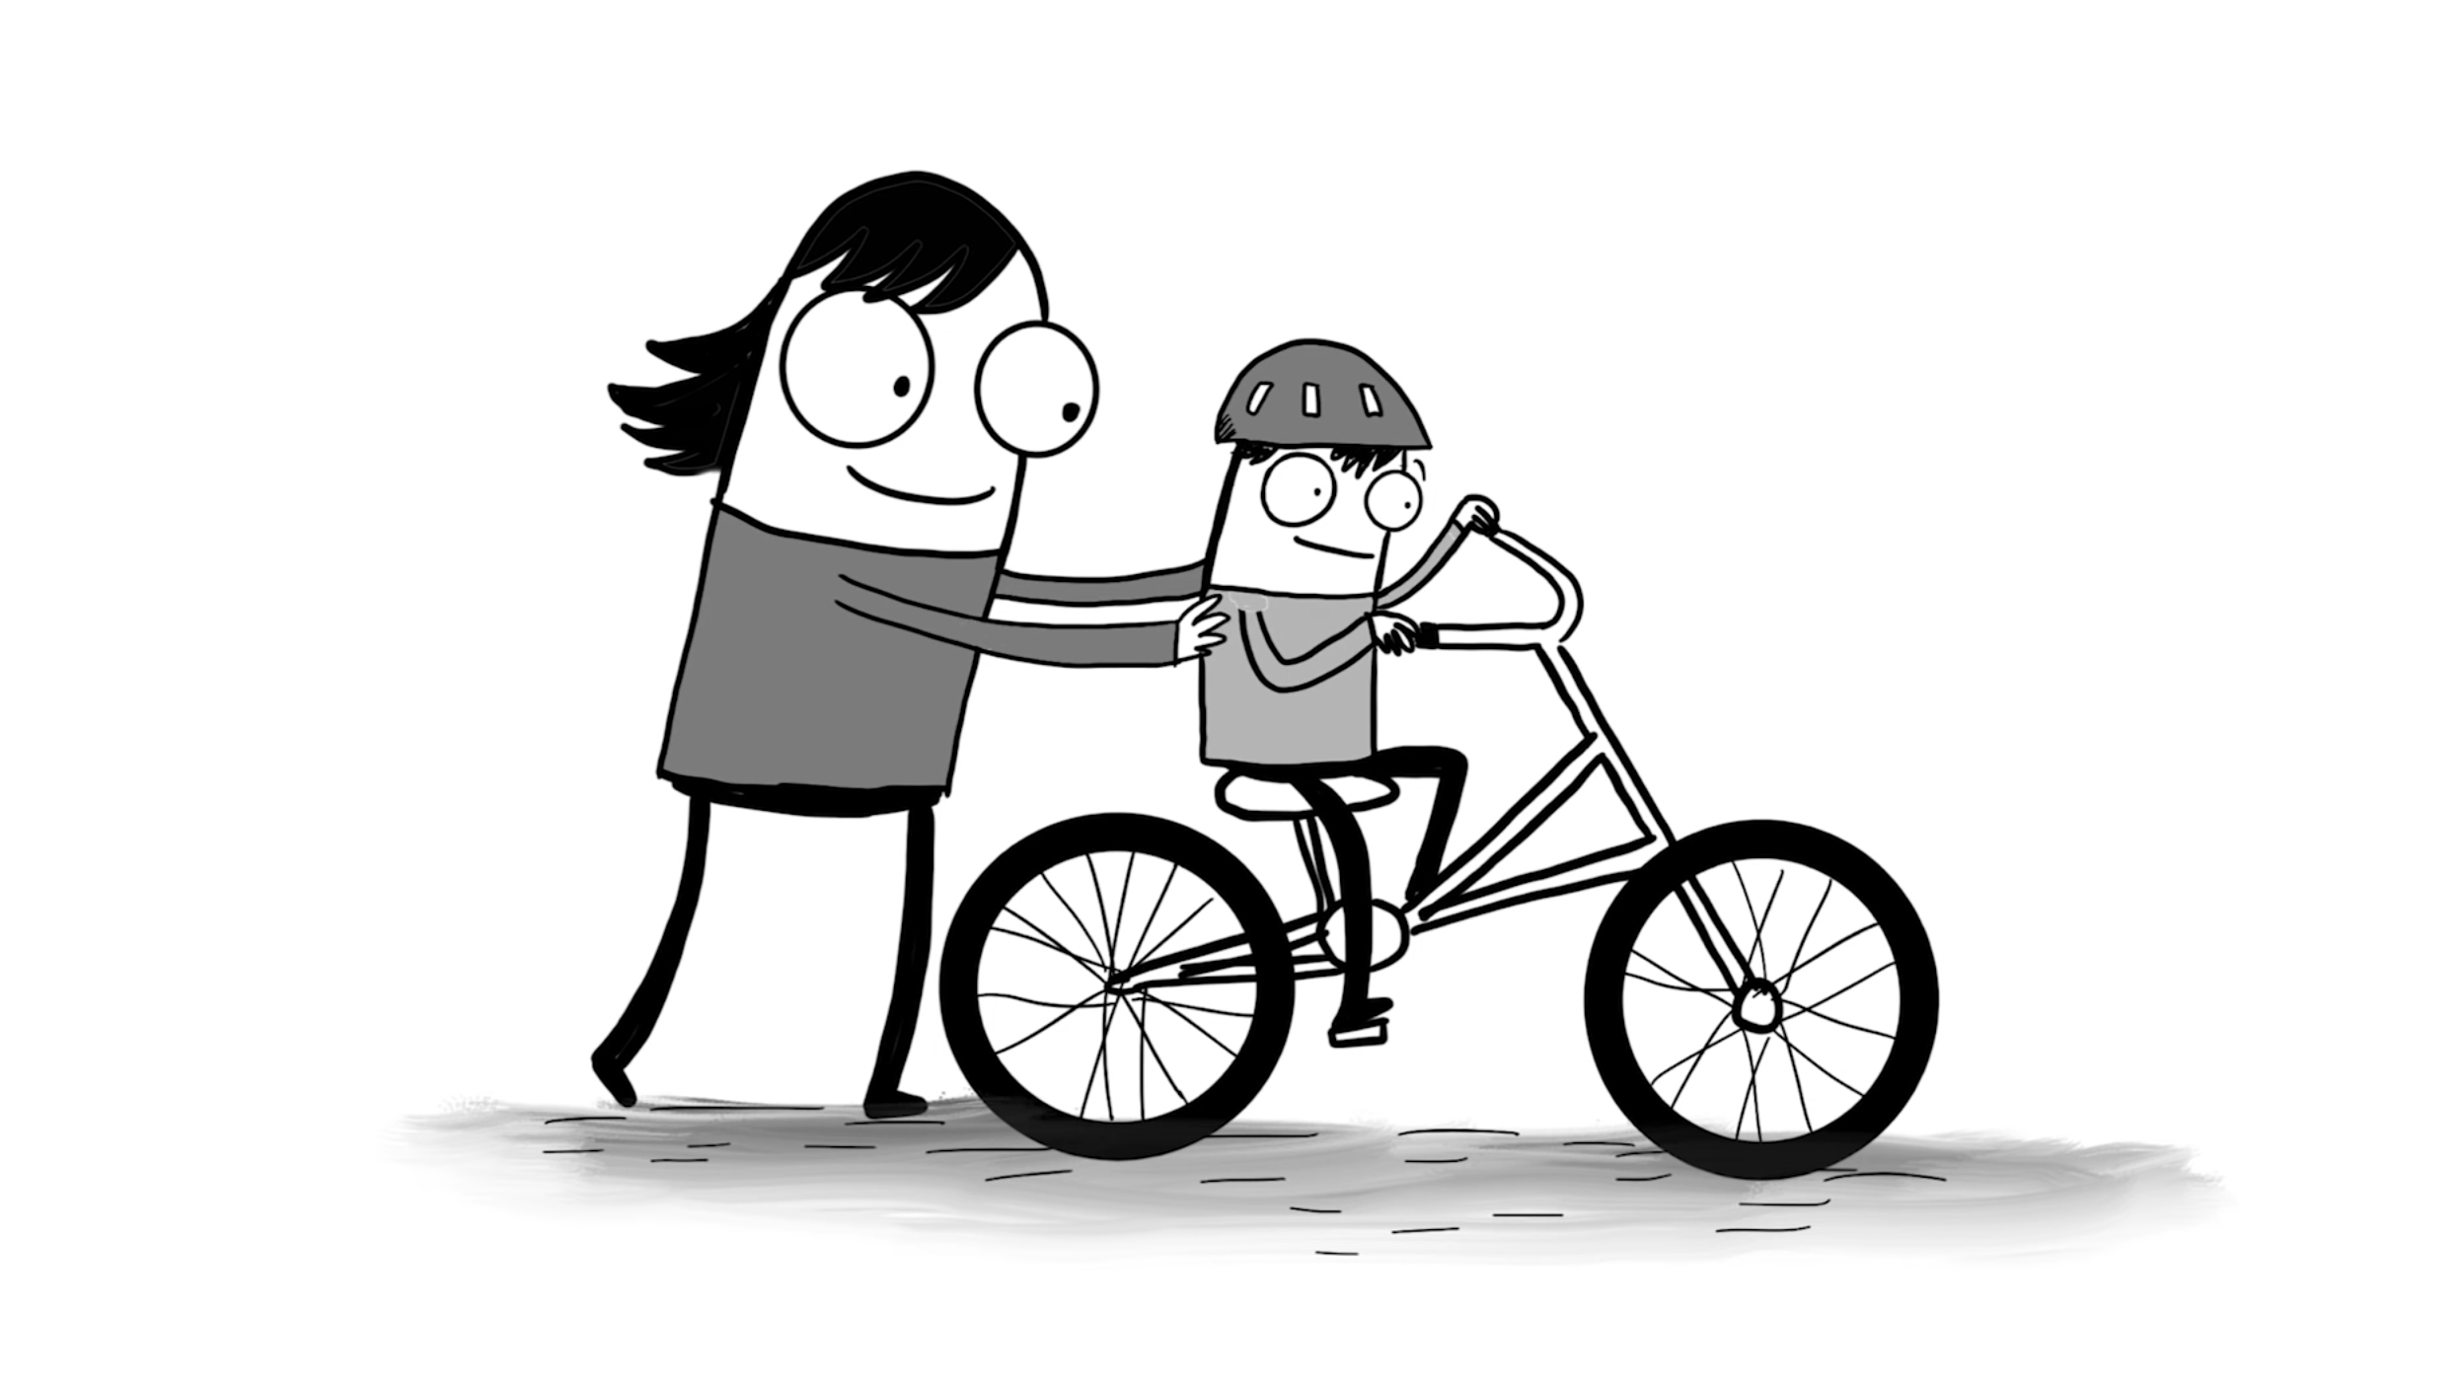
Notes:
Think about a time when you learned something, then you still remember and use it today,
Like throwing a baseball, or riding a bike.
I remember learning to ride a bike from my mom when I was 10 years old
She took off the training wheels of my bike
She god behind me, and began to push
And we ran, and ran,
Until she finally let go.
And I began to ride a bike
That’s what I did, that’s how I learned to ride a bike.
I can still ride a bike to this day from that moment.
But Can you imagine if I tried to learn to bike from my mom in a classroom? What it would look like?

Slide 15
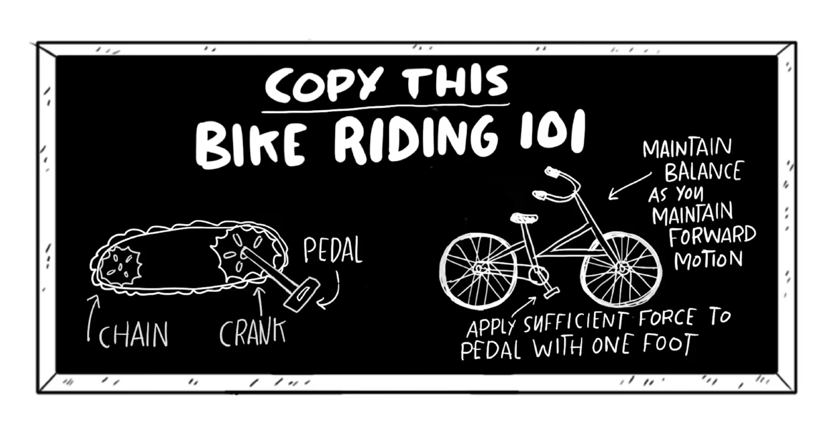
Notes:
Son, here is our Bike riding 101 class.
First, you need to learn all the parts of a bike
There’s the pedals and the crank, and there’s a chain that turns the wheel.
You need to apply significant force to the pedal
Once the wheels start rolling, you can keep your balance and repeat that again
That’s how a bike works
I want you to learn all the parts, be able to label them and draw them
Then you’ll going to learn and write a research paper about the history of bikes
All the adventure, the development of bikes, all the important elements
And at the end of that, you’re going to take a final examination
If you passed and get an A, you can ride a bike.
At 10 years old, I think I would say: never mind, I’ll just walk.
This is exactly what we do to our students.
We put them in a classroom, and tell them
This is what I want you to learn. Its important. Do it.
And They know, it is not true. , and We don’t really value learning in this way.
That’s why they’re getting bored and disengaged.
Kid want us to be learners, not simply teachers.
With that, we need to learn how to put our humanity into our class.

Slide 16
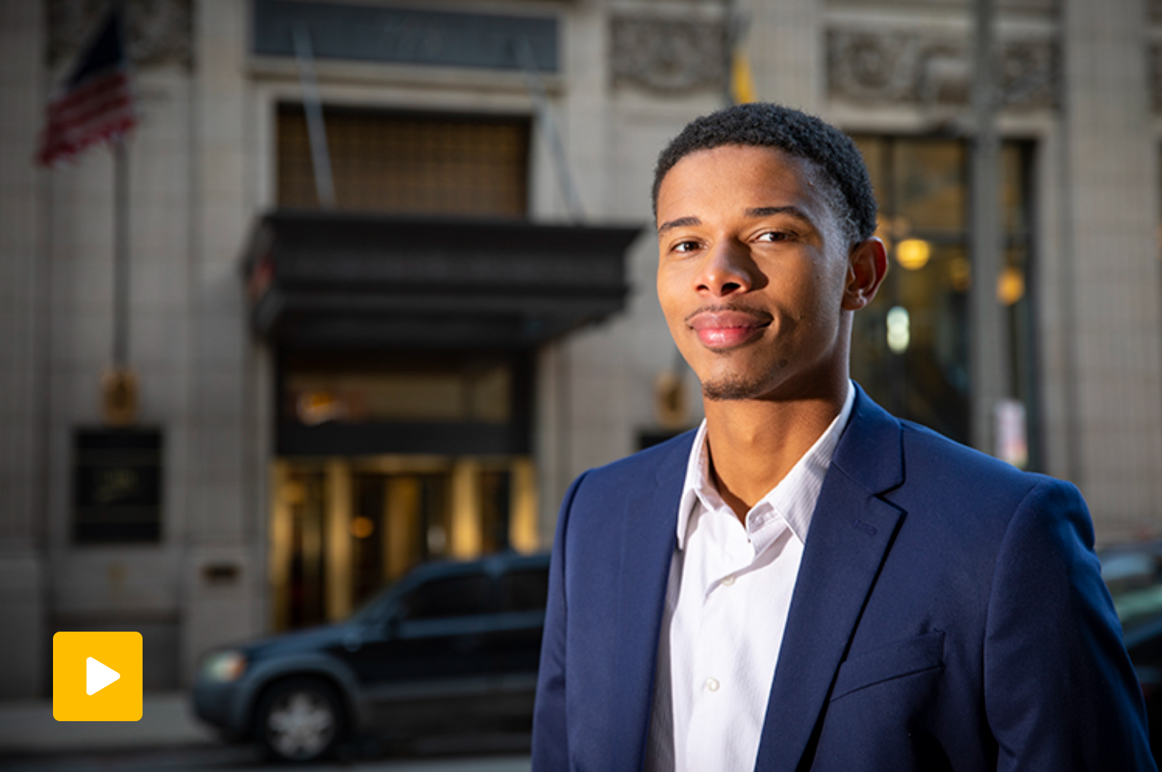
Notes:
I’ll tell you one of the greatest students in my class:
I asked his permission to include his life stories, so I’m really thankful to him.
Josh is a first-generation college students. His family was pound of him, it makes him so confident,
His first year was not very involved – he thinks he can deal with anything alone.
It turned out not to be easy for college life.
On second year, Josh was placed on academic probation, and end of taking a year off the school.
He said, once I left away, I really want to come back and grab that opportunities for my future.
So, I met him when he come back.
He said, well, my life in school is way more different than the life outside a school.
I just thought: well, how hard is your life? Your job is to do school, my job is to teach.
He just said, it’s not that simple for my family, my parents, you will not really understand, but I will do my best in your class.
He has such a desire to learn after he come back. Eventually, I learned from Josh what he needed to learn.
He participated in class, he led the discussion, and he put up a lot of questions,
And I though he became pretty good and really did well on his schoolwork.
I noticed one day, he stopped turning in his homework.
When this happened, I was quite surprised.
So, I went up to him and said, Josh, I haven’t seen your homework a few times.
He said, I know, professor, I’m sorry, I expected it turned in tomorrow.
Tomorrow came, and a few pieces of unfinished work are on my desk.
I went up to him and said, josh, this is disappointing.
He said, I normally do my homework in the school library
But this week the library was closed. I have to get back to my house to do homework
I don’t have my own bedroom, so I have to do my homework in the bathroom. Because that’s the quietest place in my house.
I didn’t finish my homework, and I’m sorry.
I immediately realized, I missed the point he mentioned.
I did not listen the word when he said, I’m trying, professor.
I heard his words, but I didn’t listen.

Slide 17
3 The Love of Humanity
Notes:
A great teacher should notice when there is a struggle
They often don’t make assumptions about what kids can and cannot do
They wait and watch and rescue them when students are getting stuck.
Good teachers hear them, but they don’t listen.
I’m really grateful for josh, and for grateful for the mistake I made.
Whenever I see an answer of a student like that:
“Sorry professor, My grandma was passed away, so I can’t made it to the exam”
“Professor, I have a very important job interview, can you send me the course materials today?”
I remember his story, and I always listen.
That story, from my word, is the love of humanity.

Slide 18
Love Makes A Teacher Great Support, Changes and Humanity
Notes:
I have so many reflections of my role as a teacher.
What students come to college, what are they really looking for?
1. Firstly, We often think a teacher should teach knowledge to students,
But a great teacher make themselves humble before their students.
Students take risks, and want to trust if they fail, they are going to be supported.
But students don’t see this.
2. They see experts. Do you remember? Content experts. All the time.
What if we hire teachers not to be deep content experts, or knowledge keepers,
But deep understander of students. And expressing the love to students, not knowledge?
How would our schools change and transform?
3. Many parents put a lot of loves to their kids. They expect them to surpass themselves, as a better version of themselves
Can we bring this to our class, and more importantly, bring the love to the students so they can grow as a stronger future?
We need to put love to our students. Our classrooms are the future.
The Bill Gates and his foundations, the mother Theresas, the Steve Jobs, the Elon Musks of the world, they are all inspired by the professors in the college.
Can you imagine, if we had a chance to go back decades ago, and take the time to ask those students,
What would make a good teacher great?
I believe, they will agree, Love makes a good teacher great. And there was good teachers, that transformed their life.
If we put love into our students, we could transform our schools and education.
Thank you.

Slide 19
Teaching Philosophy: Key Takeaways
1. The Love of Support
Emotional > Technical
2. The Love of Learning and making Changes
Keep self-learning embrace changes
Pandemic, online course, anything in the future
3. The Love of Humanity
Give Enough love, freedom, support
Trust them they can become a better person

Slide 20
2. Key Implementation
Notes:
A great teacher will be remembered by students throughout their lifetime. Since 2020, Many instructors have been facing a challenge of how to deliver effective courses to future health care professionals during the pandemic. In this 20-minutes talk, Ling Tong will summarize his experience in teaching. This talk includes three points: (1) How to effectively support students during pandemic in an online class; (2) How to have students engaged to the course materials, and (3) How to integrate love and humanity to students in a class. Ling will provide his answer to the ever-existing question for teaching: “What makes a good teacher great”, and use his teaching philosophy to answer this question.

Slide 21
Practical Questions:
Q: How to engage students (in-class)?
Q: How to do well in an online learning environment?

Slide 22
HKR + R Theory
- A practical guideline for meaningful video
- From a Youtuber’s case study: MediaStorm (影视飓风)
Happiness
Knowledge
Rhythm
Resonance

Slide 23
Q: How to engage students (in-class)?
HKR + R Theory
Happiness: Keep Supportive, even the feeling is down (pack your mood)
Knowledge: Requires instructor to keep learning and making changes
Rhythm: A demonstrated effective Course Design
Resonance: Use life faith to resonate with students (humanity)

Slide 24
3. Questions
Notes:
A great teacher will be remembered by students throughout their lifetime. Since 2020, Many instructors have been facing a challenge of how to deliver effective courses to future health care professionals during the pandemic. In this 20-minutes talk, Ling Tong will summarize his experience in teaching. This talk includes three points: (1) How to effectively support students during pandemic in an online class; (2) How to have students engaged to the course materials, and (3) How to integrate love and humanity to students in a class. Ling will provide his answer to the ever-existing question for teaching: “What makes a good teacher great”, and use his teaching philosophy to answer this question.

